Slide 1
Analysing Pizza sales dataset (using MySQL)

Slide 2
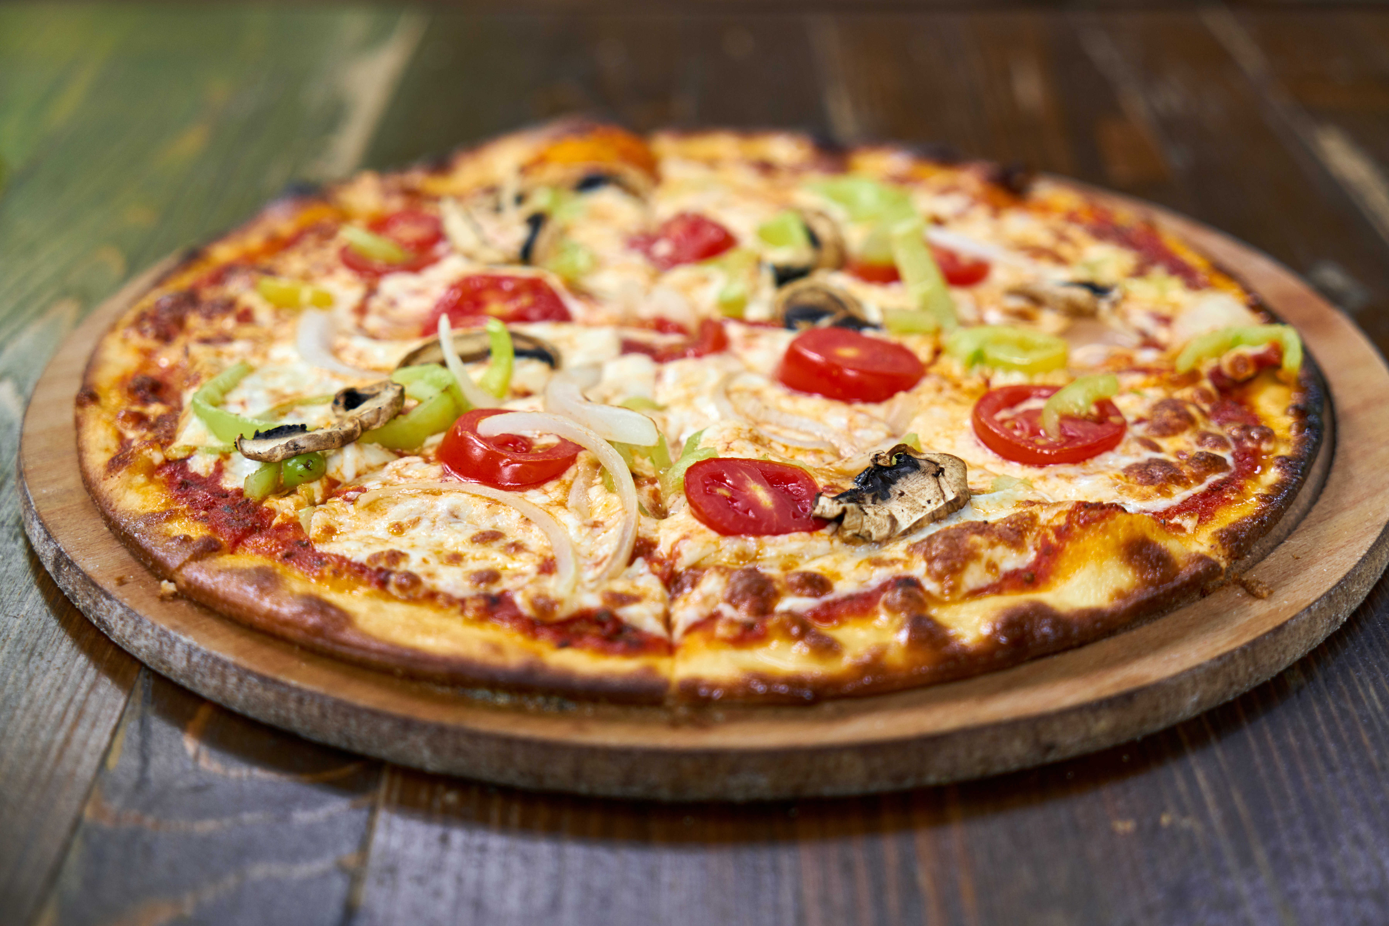
Case study
The pizza industry is a dynamic and thriving market that has undergone significant growth in recent years, with a multitude of players vying for a share of the market. Pizza remains a favourite food choice for many consumers, with the industry constantly innovating to meet changing tastes and preferences. The industry faces various challenges, including rising ingredient costs, labour shortages, and increased competition, but remains resilient in the face of these obstacles.
I, the CEO of this thriving industry is asking you to assist my team in making major decisions in identifying the KPIs that can help me grow my business and share a basic report to share with wider businesses, helping to drive growth and success in this competitive market.

Slide 3
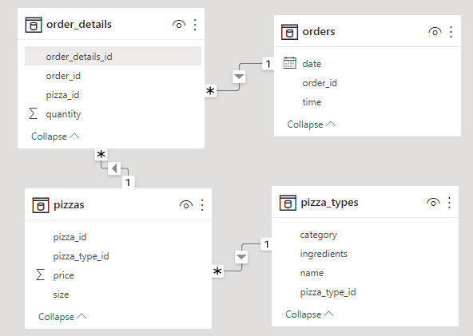
Tables and Connections

Slide 4
MySQL functions used in this report:
ADD COLUMN for adding a new column to a table
UPDATE for updating the values in a table
DAYNAME() for extracting the day name from a date
LOWER() for converting a string to lowercase
LEFT() for extracting a specified number of characters from the beginning of a string
RIGHT() for extracting a specified number of characters from the end of a string
CONCAT() for concatenating two or more strings
SUM() for calculating the sum of a column
GROUP BY for grouping the result set based on one or more columns
ORDER BY for sorting the result set by one or more columns
LIMIT for limiting the number of rows returned by the query
CASE WHEN for creating conditional expressions
STR_TO_DATE() for converting a string to a date or time value
INNER JOIN for joining multiple tables based on a common column

Slide 5
Case Study Questions
Share details of top 5 best-selling pizzas.
What is the most popular pizza size among customers?
On which day do we sell the most pizzas?
During what time of day are the most pizzas ordered?
What are the top 5 orders in terms of revenue?
Which pizza category is in highest demand?
What is the highest number of pizzas ordered by a single customer?
Do we sell more pizzas on weekends or weekdays?

Slide 6
Key Takeaways
The highest selling pizza is “Classic Deluxe Pizza”(Clearly my taste doesn’t matches with majority!).
People prefer “Large Pizzas”.
Most Pizzas are sold on “Thursdays”(People like me who starts getting weekend vibes from Thursdays itself :P).
Most Pizza are sold are sold from 12 noon to 6pm ( I prefer late night eating, again not in majority!:P).
The category most in demand is “Classic” .
The highest ordered pizza by a single customer is “28”( Seems like a big fat party!:P).
Most pizzas are sold over “Weekdays”.

Slide 7
THANK YOU

